Slide 1
GROUP 4
B Dileep
MVNS Prathyusha
Rohit Hurkadli
Navya Rani
K Mahantesh

Slide 2
INDEX
Fundamentals of Hardware
Windows Fundamentals
Linux Fundamentals
Network Fundamentals
Network Services
Database Fundamentals
Applications
Storage

Slide 3
Fundamentals Of
Hardware

Slide 4
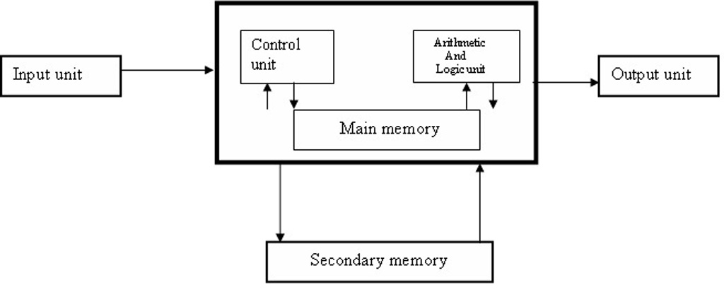
COMPUTER
Computer is an electronic device which is used to perform analytical and logical operations, by taking the input and processing it and giving the output.
HARDWARE:
Computer hardware is the collection of
physical parts of a computer system.
EX: monitor, keyboard, and mouse
SOFTWARE:
Software is a term for a set of instructions,
which makes a computer to perform a task.

Slide 5
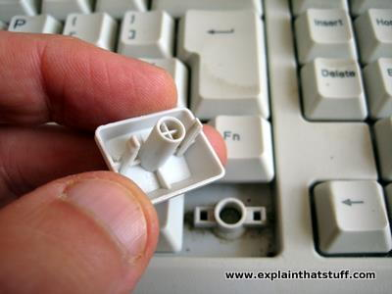
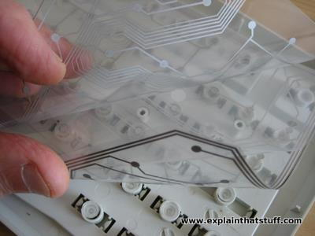
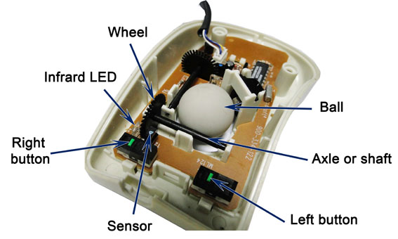
INPUT DEVICES: An input device is a hardware or peripheral device used to send data to a computer
KEYBOARD:
Mechanical Keyboard Membrane Keyboard
MOUSE

Slide 6
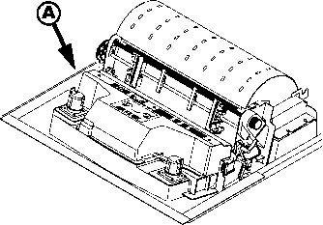
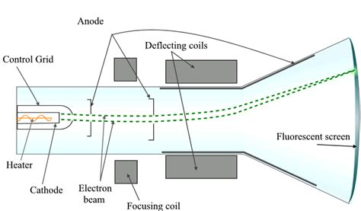
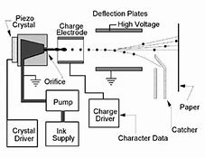
OUTPUT DEVICES: An output device is a part of the computer that receives the processing from the computer and presents or displays it.
Dot matrix printer
CRT Monitor
Inkjet printer

Slide 7
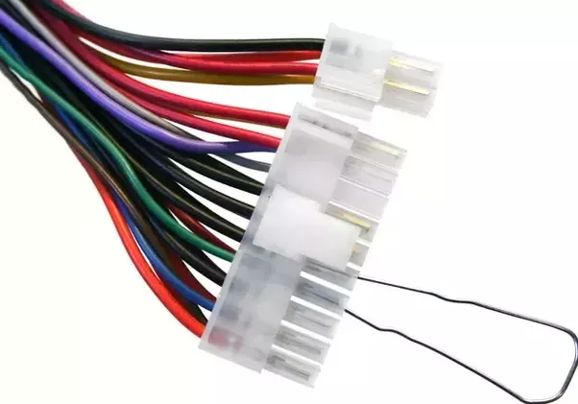
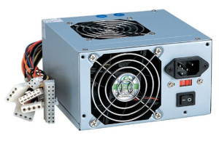
SWITCHED MODE POWER SUPPLY(SMPS)
A switched-mode power supply is an electronic power supply that incorporates a switching regulator to convert electrical power efficiently.
Rectification
Filtration
Regulation

Slide 8
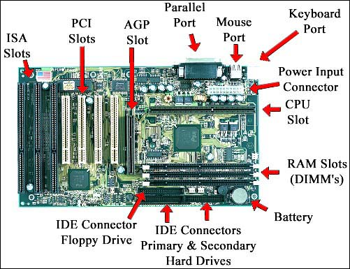
MOTHERBOARD A printed circuit board containing the principal components of a computer or other device

Slide 9
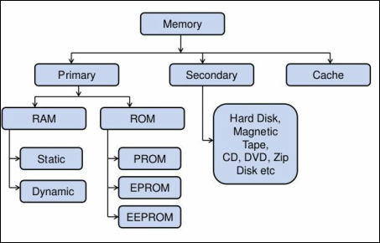
MEMORY AND IT’S TYPES Memory refers to the computer hardware devices used to store information for immediate use in a computer

Slide 10
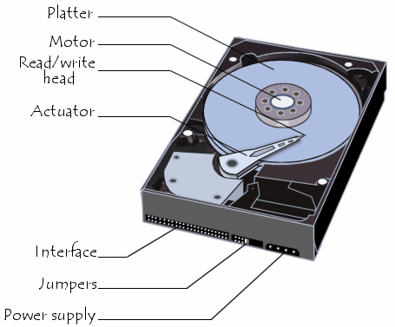
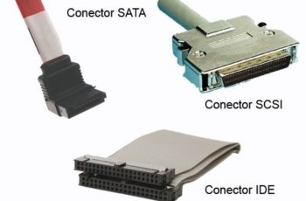
HARDDISK A rigid non removable magnetic disk with a large data storage capacity

Slide 11
WINDOWS FUNDAMENTALS

Slide 12
INTRODUCTION TO OS
An operating system or OS is a software program that enables the computer hardware to communicate and operate with the computer software.
Without a computer operating system, a computer and software programs would be useless.
Types of operating Systems :
Network Operating System
Real Time Operating System
Distributed Operating System
Multi tasking Operating System
Embedded Operating System

Slide 13
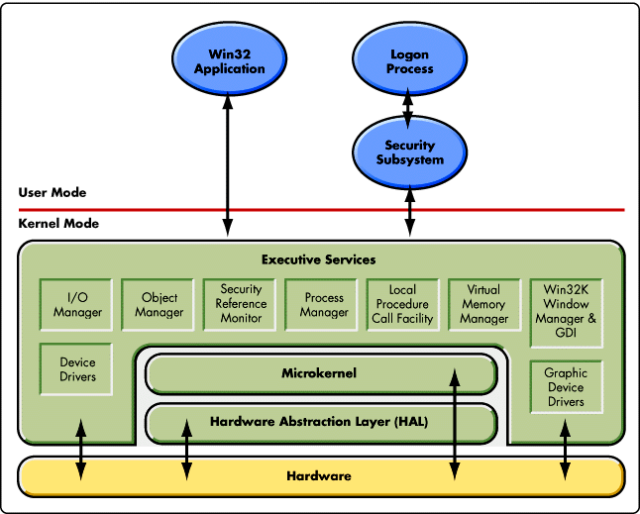
Windows Kernel and Architecture
The kernel acts an interface between the application and the hardware
Monolithic
Micro kernel
Hybrid Kernel

Slide 14
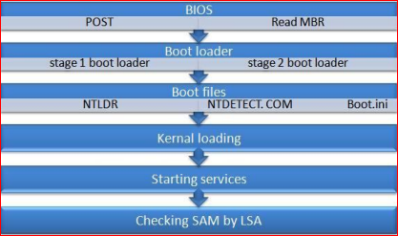
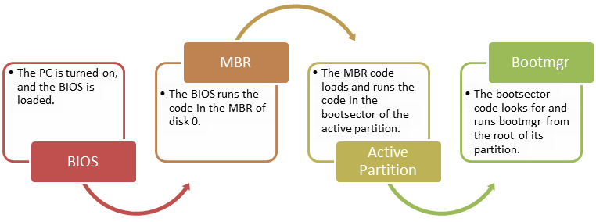
BOOTING PROCESS

Slide 15
Windows File System
The structure and logic used to manage the groups of information is called a "file system".

Slide 16
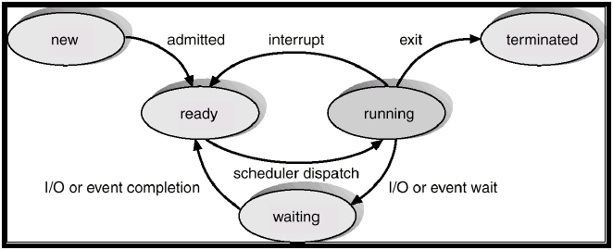
Process Management
Process Types:
Multi processing
Multi tasking
Multi threading
Hyper threading
Process State Diagram

Slide 17
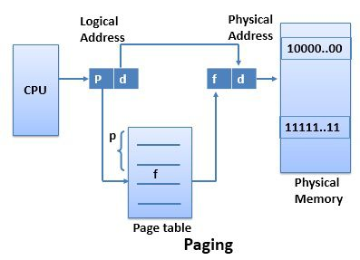
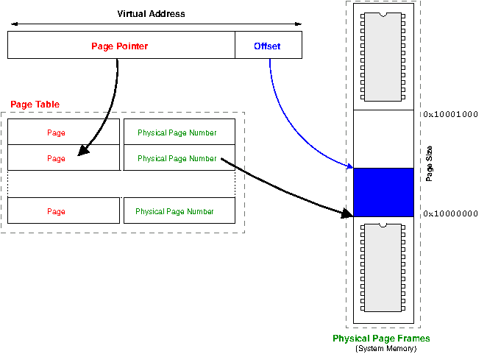
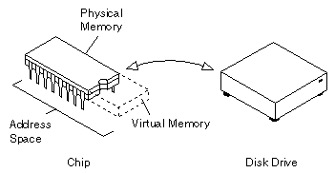
Memory Management
Virtual Memory
Virtual Address Space

Slide 18
LINUX FUNDAMENTALS

Slide 19

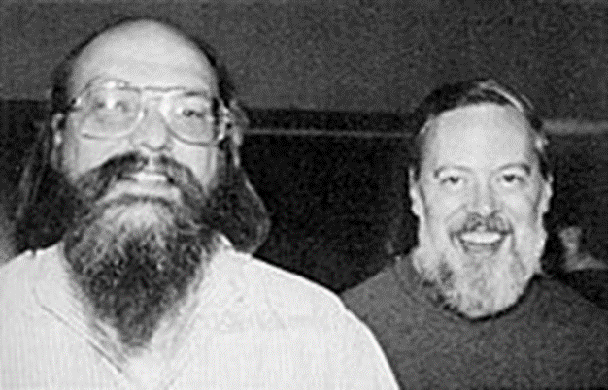


History of Linux
The Unix operating system was developed by Ken Thompson and Dennis Ritchie at
AT & T Bell LAB in 1969 and released in 1970.

Slide 20
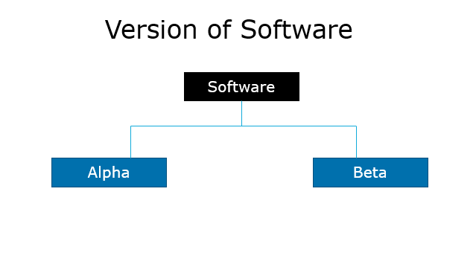
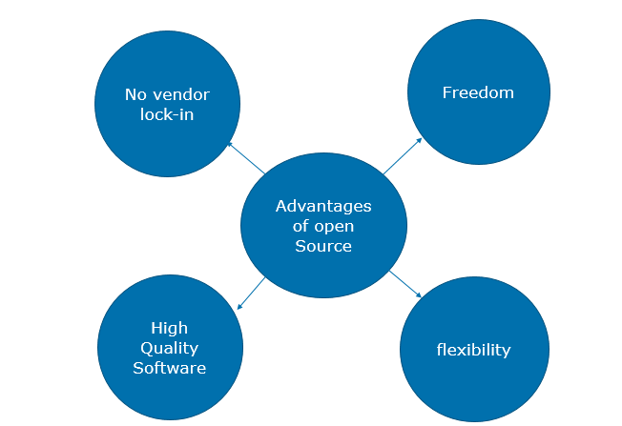
Software

Slide 21
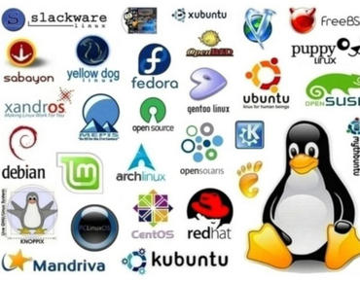
Distribution of Linux

Slide 22
Linux Subsystem
LINUX
USER APPLICATION
OS SERVICES
HARDWARE CONTROL
LINUX KERNEL

Slide 23
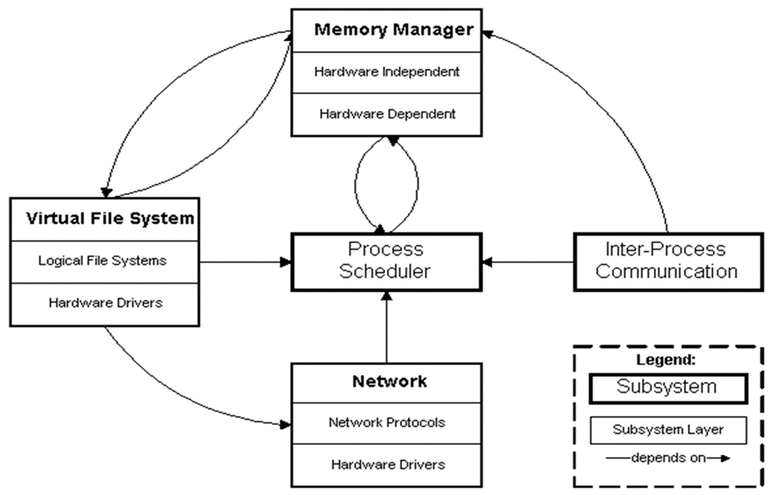
Kernel Subsystem

Slide 24
Booting process
Power/On
BIOS
MBR
GRUB
RUNLEVEL
INIT
KERNEL

Slide 25
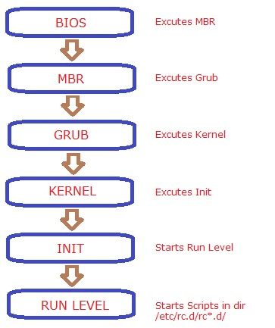
Booting process

Slide 26
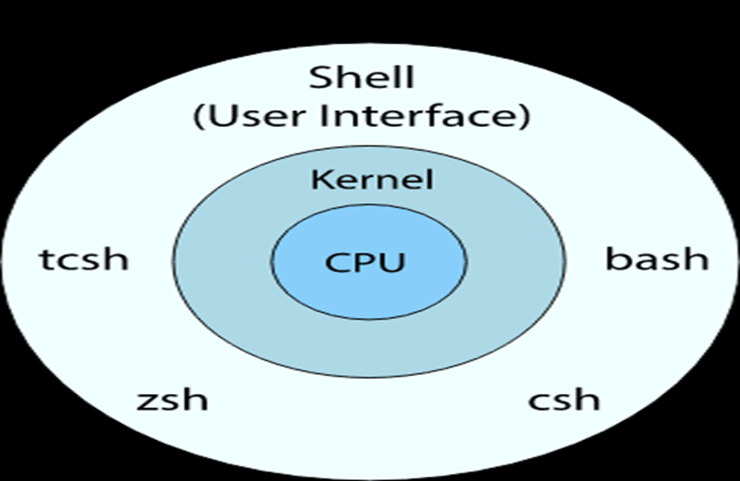
SHELL
The shell is the layer of programming that understands and executes
the commands a user enters.
Types of shell
Ash
Bourne
Bash
Corn
T-shell
C-shell
Z-shell

Slide 27
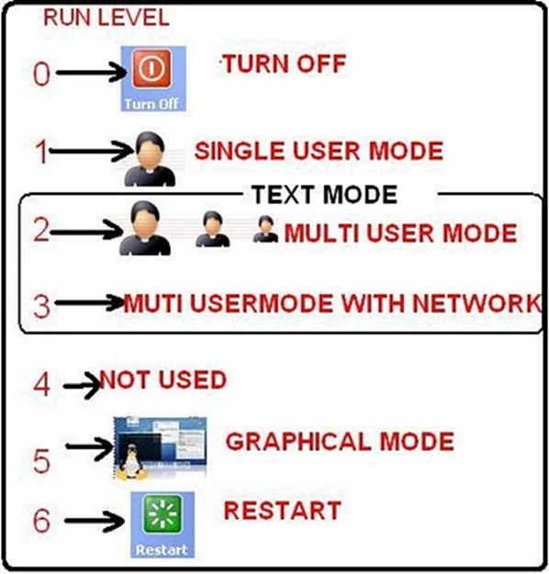
RUN LEVELS
Run level is a mode of operation in one of the computer operating systems
0-Halt
1-Single User mode
2-Multiuser mode without Network
3-Full multiuser mode
4-Unused
5-GUI
6-Reboot

Slide 28
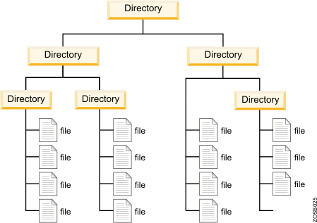
FILE SYSTEM
Linux File System or any file system generally is a layer which is under the operating system that handles the positioning of your data on the storage, without it
TYPES OF LINUX FILE SYSTEM
Ext 2
Ext 3
Ext 4
TYPES OF JOURNALING
Write back
Ordered
Data

Slide 29
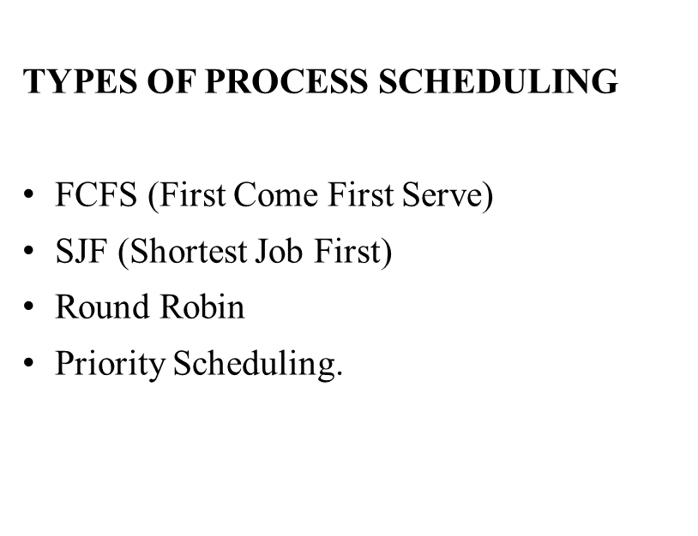
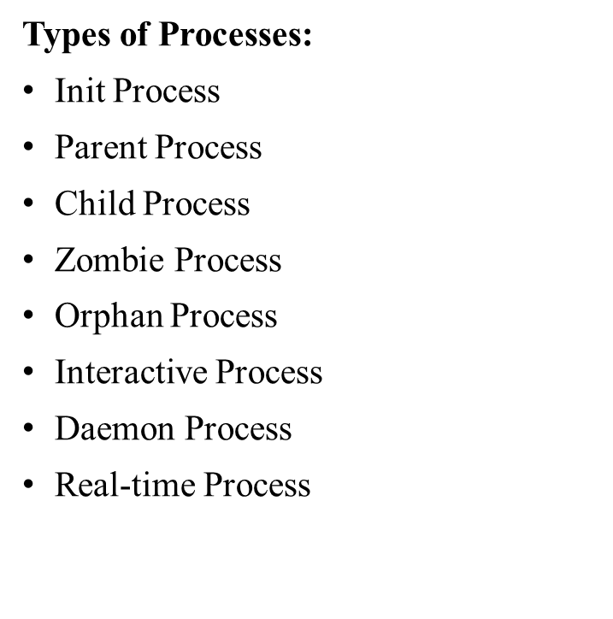
Process Management

Slide 30
DEVICE MANAGEMENT
Device files(/dev)
IRQ
Device Files
Character Devices
Block Devices

Slide 31
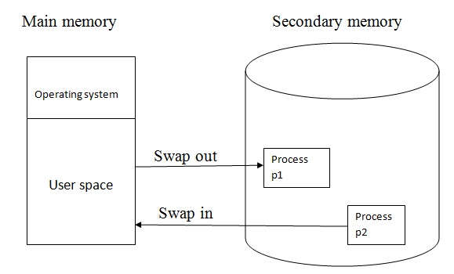
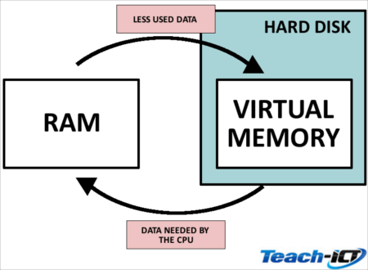
Memory Management
Virtual memory
Memory swapping
Memory Management Algorithms
BUDDY Algorithm
LRU

Slide 32
NETWORK FUNDAMENTALS

Slide 33
NETWORK
A network is a collection of computers, servers, mainframes, network devices, peripherals, or other devices connected to one another to allow the sharing of data.
Characteristics of Network
Fault Tolerance
Scalability
Quality of Services
Security

Slide 34
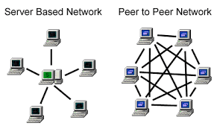
NETWORK ARCHITECTURE
Network Architecture provides the detail overview of a network. It is used to classify all the network layers step-by-step in logical form by describing each step in detail.

Slide 35
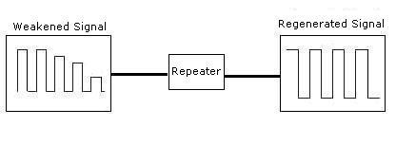
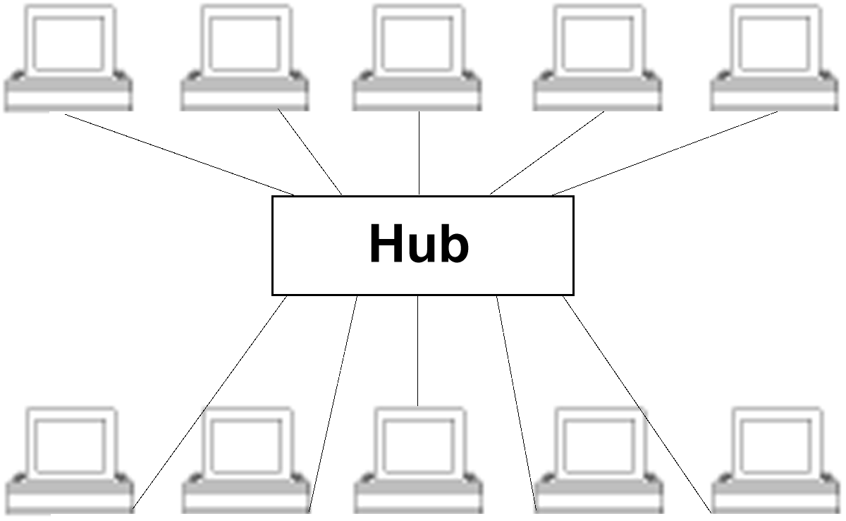
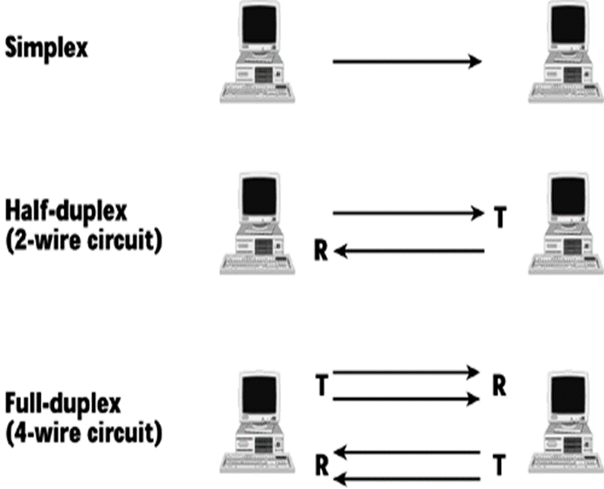
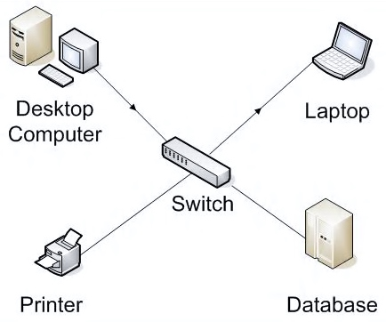
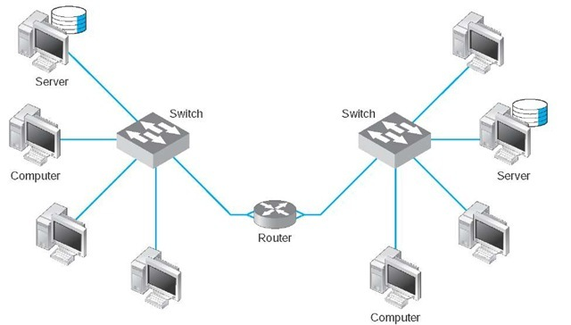
Network Devices
COMMUNICATION TYPES:

Slide 36
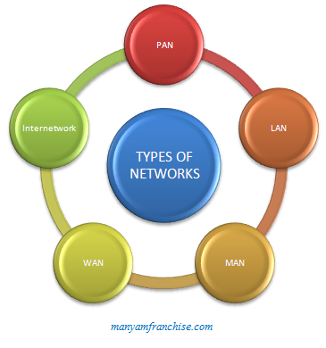
NETWORK
A network is a collection of computers, servers, mainframes, network devices, peripherals, or other devices connected to one another to allow the sharing of data.
Types of Network
LAN
WAN
MAN
WLAN
PAN
CAN
DAN
SAN

Slide 37
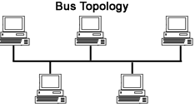
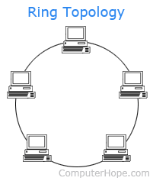
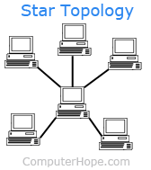
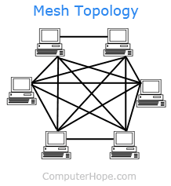
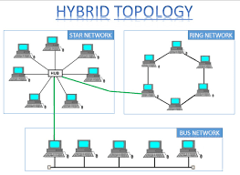
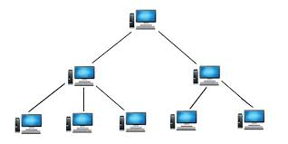
NETWORK TOPOLIGES
Tree Topology

Slide 38
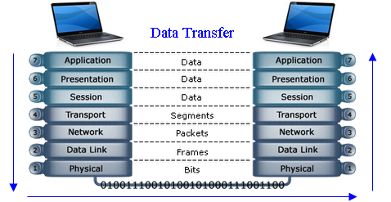
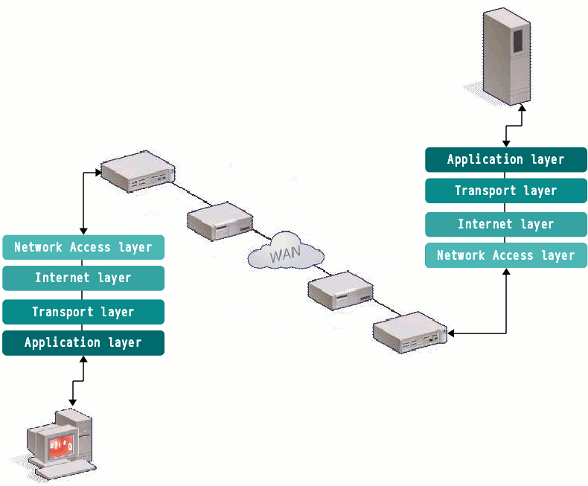
OSI MODEL
TCP/IP MODEL

Slide 39
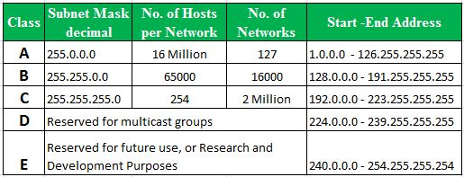
IP ADDRESS CLASSES
An IP address, short for Internet Protocol address, is an identifying number for a piece of network hardware. Having an IP address allows a device to communicate with other devices over an IP-based network like the internet.
Sub netting: Sub netting allows you to create multiple logical networks that exist within a single Class A, B, or C network. If you do not subnet, you are only able to use one network from your Class A, B, or C network, which is unrealistic.

Slide 40
Network Services

Slide 41
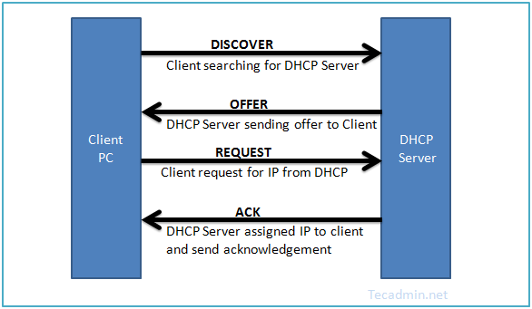
DHCP(Dynamic Host Configuration Protocol)
It is used for automatic configuration of client network services.

Slide 42

DNS(Domain Name Server)
It translates internet domain and host names to IP addresses.
1.DNS Records
2.DNS Client side Caching
3.DNS Hierarchy

Slide 43

Directory Services
It is a database that contain information about all objects on the network.
LDAP
1.Information Model
2.Naming Model
3.Functional Model
4.Security Model

Slide 44

Mail Services

Slide 45


Proxy Service
It Performs actions between client(user) and Server(Internet).

Slide 46

Web Service

Slide 47
Fundamentals Of
Database

Slide 48

HISTORY OF DATABASE
A database is a collection of information that is
organized so that it can be easily accessed,
managed and updated.

Slide 49

Architecture of Database
DATA ANOMALIES
Insert
Update
Delete
Keys
Super key
Candidate Key
Primary Key
Alternate Key
Composite Key
Foreign Key

Slide 50
EF Codd Rules:
Structural Rule
Rule 1: Rule of Information
Rule 6: Rule of Updating Views
Integrity Rule
Rule 3: Rule of Systematic Null Value Support
Rule 10: Rule of Integrity Independence
Data Manipulation Rule
Rule 2: Rule of Guaranteed Access
Rule 4: Rule of Active and online relational Catalog
Rule 5: Rule of Comprehensive Data Sub-language
Data Independence Rule
Rule 8: Rule of Physical Data Independence
Rule 9: Rule of Logical Data Independence
Rule 11: Rule of Distribution Independence
Foundational Rule
Rule 12: Rule of Non Subversion
Rule 0: Foundation rule

Slide 51
Normalization
Normalization is a method for organizing data elements in a data base into tables
1 NF
Employee No | Employee Name | Department
1 | Amit | OBIEE,ETL
2 | Divya | COGNOS
3 | Rama | Administrator
Employee No | Employee Name
1 | Amit
2 | Divya
3 | Rama
Employee No | Department
1 | OBIEE
1 | ETL
2 | COGNOS
3 | Administrator

Slide 52
2 NF
Employee No | Department No | Employee Name | Department
1 | 101 | Amit | OBIEE
2 | 102 | Divya | COGNOS
3 | 101 | Rama | OBIEE
Employee No | Department No | Employee Name
1 | 101 | Amit
2 | 102 | Divya
3 | 101 | Rama
Department No | Department
101 | OBIEE
102 | COGNOS

Slide 53
3 NF
Employee No | Salary Slip No | Employee Name | Salary
1 | 0001 | Amit | 50000
2 | 0002 | Divya | 40000
3 | 0003 | Rama | 57000
Employee No | Salary Slip No | Employee Name
1 | 0001 | Amit
2 | 0002 | Divya
3 | 0003 | Rama
Salary Slip No | Salary
0001 | 50000
0002 | 40000
0003 | 57000

Slide 54
APPLICATIONS

Slide 55

APPLICATION PROGRAMMING INTERFACE(API)
An application program interface (API) is code that allows two software programs to communicate with each other.
TYPES OF APPLICATION:

Slide 56


TIER ARCHITECTURE
APPLICATION SECURITY:
Application security is the use of software, hardware, and procedural methods to protect applications from external threats.

Slide 57


APPLICATION ARCHITECTURE TYPES:
Thick Client Architecture
Thin Client Architecture
Rich Internet Application

Slide 58
STORAGE
STORAGE
FUNDAMENTALS

Slide 59

STORAGE AND TYPES
Storage is a process through which digital data is saved within a data storage device by means of computing technology.
Types of Storage :
Logical Unit Number
Zoning
iSCSI

Slide 60



RAID (Redundant Array Of Independent Disks)

